Slide 1
Question
Print the maximum salary in the table
Print the row having maximum salary in the table

Slide 2
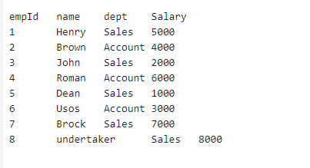


Print the maximum salary in the table
Print the row having maximum salary in the table

Slide 3
The MAX() function returns the maximum value in a set of values.

Slide 4

The MAX() function returns the maximum value in a set of values.

Slide 5
The MAX() function returns the maximum value in a set of values.
The MySQL MAX() function is used to return the maximum value in a set of values of an expression. This aggregate function is useful when we need to find the maximum number, selecting the most expensive product, or getting the largest payment to the customer from your table

